Slide 1
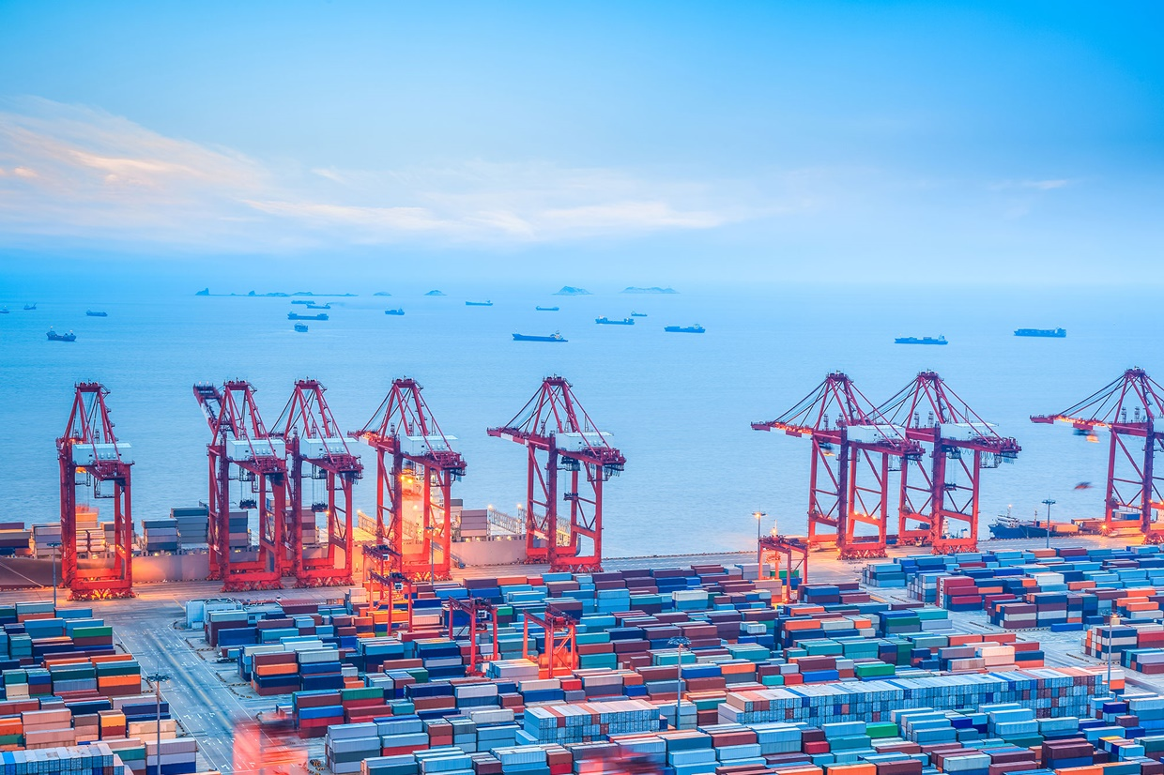

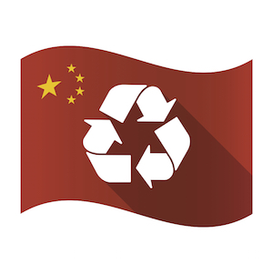
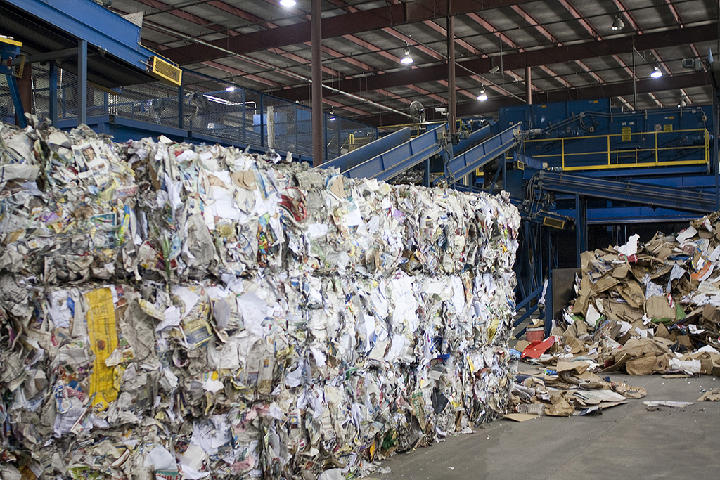

Recycling & China

Slide 2
SWANA - Background
SWANA is the largest waste association in North America with 9,500+ members
  Members/chapters in United States and Canada
  Public sector and private sector
  Our core purpose is to “advance the responsible management of solid waste as a resource.”

Slide 3
China/SWANA
SWANA has been at the center of this issue since July 2017 when China issued Notifications containing a vague waste import ban with the World Trade Organization (WTO)
  Complicated issue with wide variety of stakeholders
    Federal agencies
    State agencies
    Local governments
    Recyclers/national companies
    Foreign governments (Canada, EU)
    Other associations (ISRI, NWRA, AF&PA)

Slide 4
China Waste Restrictions Update
SWANA and other stakeholders filed initial WTO comments in late August
  Comments sought clarity re scope/timing & expressed concerns re feasibility of domestic markets by 1/1/18.
  Concern over separate 0.3% contamination standard
  SWANA encouraged others to file comments to increase and broaden the number of voices raising concerns.
Industry Stakeholders met with US Commerce Dept/USTR in September
  Commerce/USTR raised issue in Beijing in September & October at bilateral trade meetings
Notes:
4 important developments today:
WM wants SWANA to send a letter to all 50 state env agencies re the China waste import ban and suggest that they plan for disruption to municipal recycling programs. WM is preparing a draft for my review. I think this topic needs to be discussed at the SMM TD meeting next week. I don’t think we will send until after WASTECON.
Waste Connections (!) woke up and realized that they have a problem with exports to China, and contacted me. WC has exports from BC and will send me the numbers by Friday. We can use this to try and get our BC chapter, as well as Ottawa’s version of USTR, engaged on this issue. This will likely be a membership recruitment opportunity in BC as well.
OCC prices dropped today by 15-20%, due to the market’s recognition that China is banning imports.
Madison Wisconsin has decided to stop accepting rigid plastics at drop off centers due to China import ban. First Midwest impact from the ban.

Slide 5
China Waste Restrictions Update
SWANA met with EPA in early October as price and other impacts (import licenses) began to ripple through U.S.
We sent October 11 letter to all 50 state environ agencies – info update & focused on potential disruption to municipal recycling programs.
  Core messages: communicate w/ stakeholders & “quality”
We prepped Canadian WTO reps for Nov meeting.
Notes:
4 important developments today:
WM wants SWANA to send a letter to all 50 state env agencies re the China waste import ban and suggest that they plan for disruption to municipal recycling programs. WM is preparing a draft for my review. I think this topic needs to be discussed at the SMM TD meeting next week. I don’t think we will send until after WASTECON.
Waste Connections (!) woke up and realized that they have a problem with exports to China, and contacted me. WC has exports from BC and will send me the numbers by Friday. We can use this to try and get our BC chapter, as well as Ottawa’s version of USTR, engaged on this issue. This will likely be a membership recruitment opportunity in BC as well.
OCC prices dropped today by 15-20%, due to the market’s recognition that China is banning imports.
Madison Wisconsin has decided to stop accepting rigid plastics at drop off centers due to China import ban. First Midwest impact from the ban.

Slide 6
China Waste Restrictions Update
China issued new Notifications on November 15
  Prohibition on imports of mixed paper & post-consumer plastic maintained
  Slight relaxation of contamination standard to 0.5% except for non-ferrous metals (1%)
  Implementation date – March 1, 2018
• Comments due on Dec 15th
• Stakeholders likely to request less stringent contamination standard and a longer transition period
Notes:
4 important developments today:
WM wants SWANA to send a letter to all 50 state env agencies re the China waste import ban and suggest that they plan for disruption to municipal recycling programs. WM is preparing a draft for my review. I think this topic needs to be discussed at the SMM TD meeting next week. I don’t think we will send until after WASTECON.
Waste Connections (!) woke up and realized that they have a problem with exports to China, and contacted me. WC has exports from BC and will send me the numbers by Friday. We can use this to try and get our BC chapter, as well as Ottawa’s version of USTR, engaged on this issue. This will likely be a membership recruitment opportunity in BC as well.
OCC prices dropped today by 15-20%, due to the market’s recognition that China is banning imports.
Madison Wisconsin has decided to stop accepting rigid plastics at drop off centers due to China import ban. First Midwest impact from the ban.

Slide 7
Impact on States
Many state agencies are monitoring the impact of China’s new rules on state/municipal recycling programs and goals, and taking varying approaches.
  Waste Dive 50 state survey
States with high recycling rates that export a lot of material to China were the first ones being directly affected.
  Oregon, Washington, Alaska

Slide 8
Impact on States - Oregon
Oregon DEQ published FAQ’s re proposed ban and impact on recycling
“DEQ and its partners are preparing for different possibilities and developing strategies to maintain recycling collection and processing where possible….” http://www.oregon.gov/deq/mm/Pages/Recycling-Markets.aspx
DEQ has “concurred” with a handful of requests to landfill certain recyclables.
DEQ is encouraging citizens to:
- Continue to recycle whenever possible
Recycle right
Prevent waste from the start

Slide 9
Local Impacts
The impact on municipal recycling programs thus far is limited, but that is likely to change if status quo of lower prices, 0.5% contamination limit, & fewer import licenses continues
Depends on whether you export – and where
Depends on your contract (force majeure?)
Depends on your contamination level

Slide 10
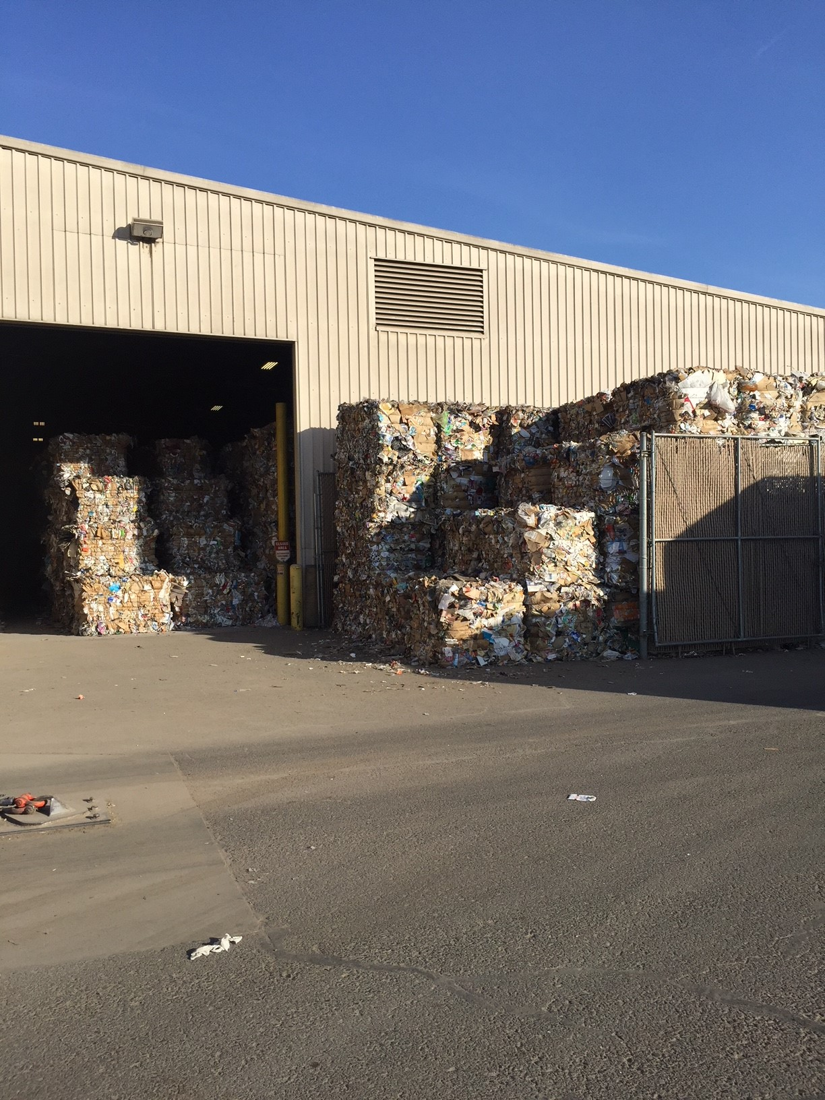
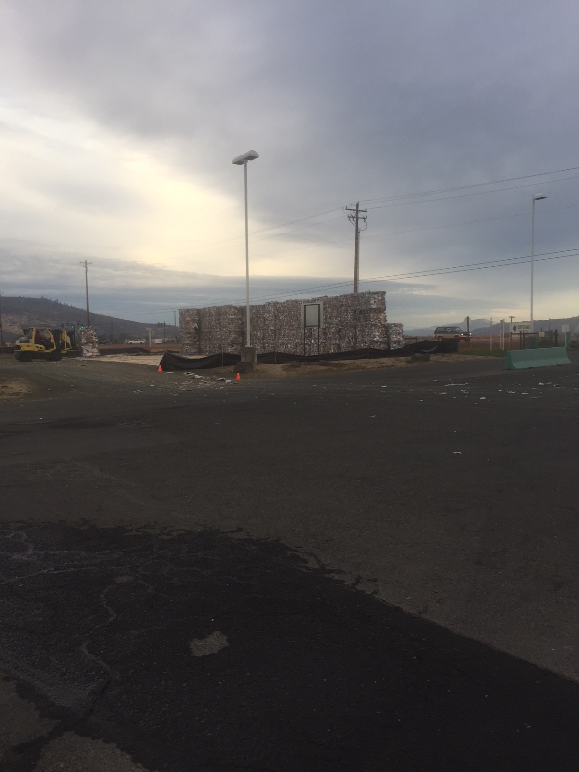
Local Impacts
In a number of localities ranging from Lane County, OR to Madison, WI to Sitka, AK, changes in recycling practices are taking place
  Mostly drop off – Plastics 3-7
  Some storage of material occurring - West Coast, N.C.

Slide 11
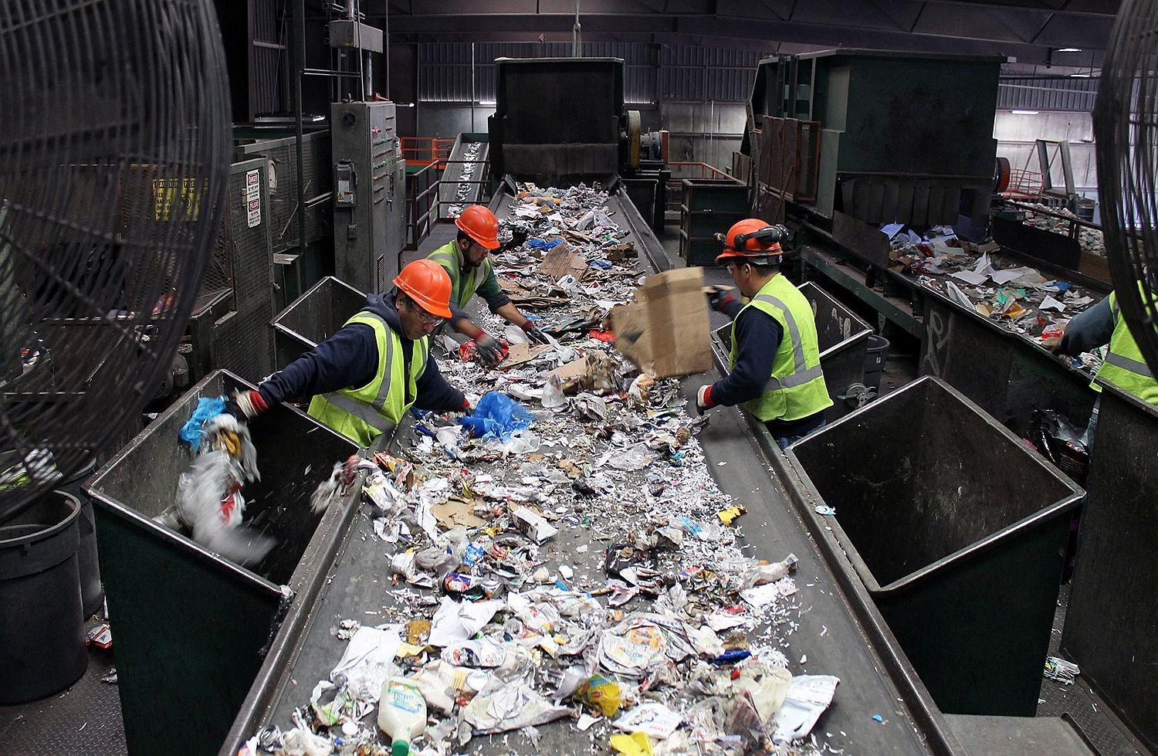
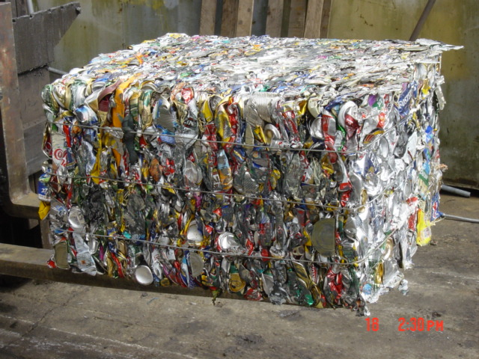
What should MRF operators be doing?
It’s About Quality!
Clean up your bales:
Slow down the line
Hire more workers
  Some MRFs having trouble finding workers
Add new technology
  Optical sorters/robotics

Slide 12
SWANA’s Advice
Everyone should take a deep breath
Communicate with all stakeholders/elected officials about the current disruption in the global recycling markets
Educate all stakeholders re need to generate high quality material
Renew waste reduction efforts
Consider alternate markets – SE Asia
Review current & future recycling goals/regs

Slide 13
Thank you!
QUESTIONS???
David Biderman
dbiderman@swana.org
240-494-2254
@biderman

